Slide 1

Data Science Capstone
Using Foursquare to identify best neighbourhoods in Greater Melbourne to visit

Slide 2
Introduction
Due to the Covid 19 pandemic small businesses have been affected in the areas of food and entertainment. Since Victoria has now come out of the pandemic, people can now travel around the state and experience what Melbourne has to offer while helping out the businesses in need.
From this project we expect to identify places to visit within the Greater Melbourne area and recommend them to people who wants to visit

Slide 3
Data Acquisition & Feature Selection
Since Greater Melbourne consists of multiple councils, the analysis was based on the councils that construct Greater Melbourne in terms of Metropolitan, Inner suburbs and Outer suburb areas. This data can be readily found in Wikipedia in the following link https://en.m.wikipedia.org/wiki/Local_government_areas_of_Victoria. Latitude Longitude coordinates of the council areas a obtained from the Geopy API.
Beautiful soup was used to web scrap the needed information.
The analysis was considered for three categories, that includes
Activities and things to do around Greater Melbourne
Restaurants and Eats around Greater Melbourne
Services around Greater Melbourne
The main importance was given to Restaurants and Eats since that category was heavily impacted by the pandemic and people has more preference towards food.

Slide 4
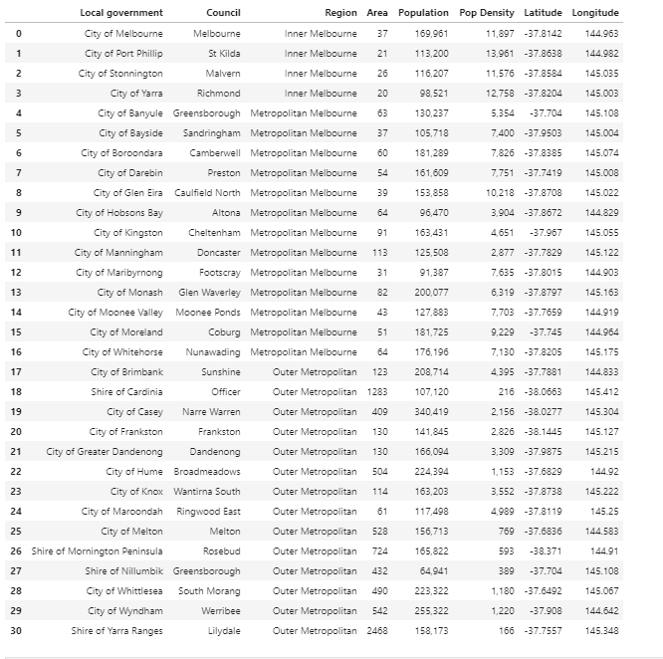
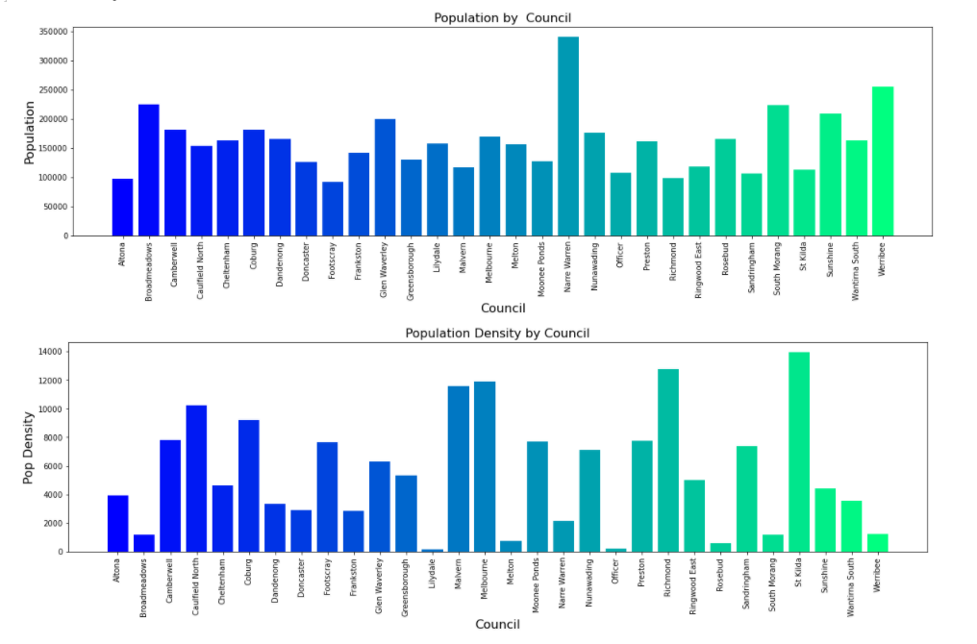
Exploratory Data Analysis

Slide 5
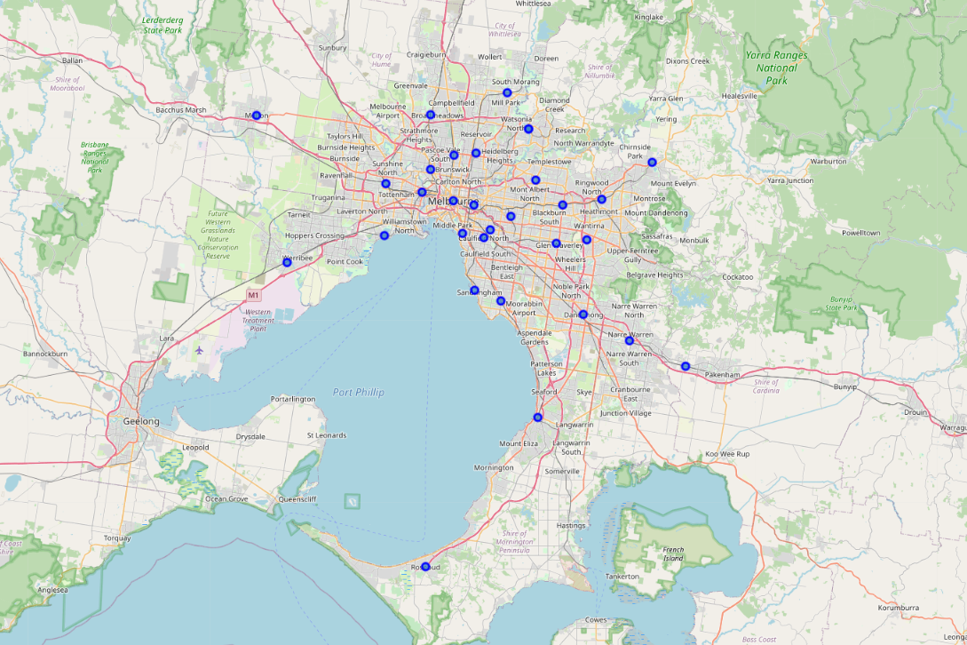

Slide 6
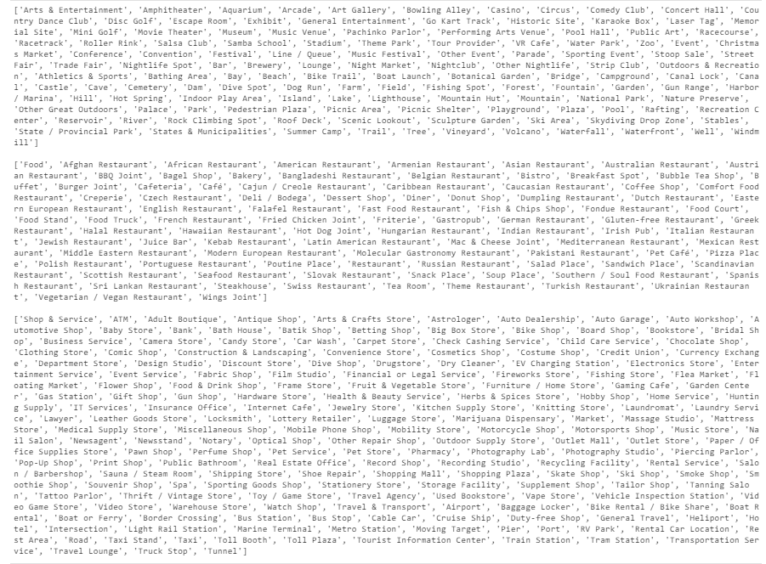
Foursqure API

Slide 7
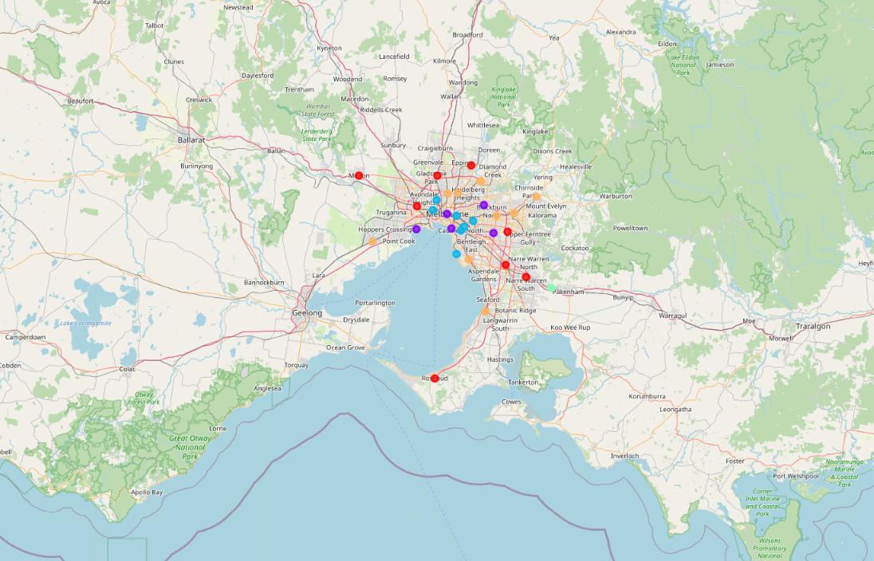
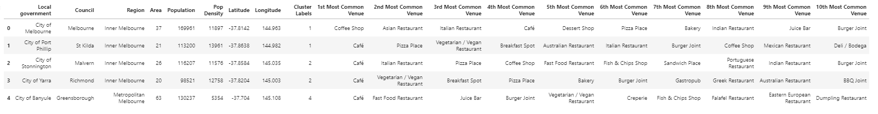
Data Clustering And Analysis

Slide 8
Conclusions
metropolitan areas are more prone to have cafes, coffee shops, whereas outer suburbs are more prone to have Fast Food and pizza shops

